Slide 1
Smart Resume Screening and Interview Prep Assistant: Milestone 1 Report
Kennesaw State University
IT 7993
Dr. Xiu
Group 2: Hanzhi Chen, Kawanda Gray, Brittany Frazier, Tomas King, & Loreli Olien
February 2026
Project Website: https://github.com/KSU-Capstone-Group-P12/Smart_Resume_Screening/

Slide 2
Agenda
Project Overview
Milestone 1 Overview
Functional Requirements
Non-Functional Requirements
Assumptions and Constraints
Project Upkeep Costs
UX Wireframe
Recruiter Dashboard Design
System Data Model Design
Gantt Chart
Tech Stack Decision and Justification
Action Plan For Milestone 2
Questions and Comments

Slide 3
Project Overview
The Smart Resume Screening & Interview Preparation Assistant is a web-based decision-support application developed to improve structure, transparency, and consistency in the early stages of candidate evaluation.
The system enables recruiters to upload resumes and input job descriptions, then performs semantic analysis to evaluate alignment between candidate qualifications and role requirements.
Instead of relying solely on keyword matching, the system uses embedding-based similarity to assess candidates across defined categories including skills, professional experience, education, and project work.
The application generates a structured candidate ranking along with explanations that clearly communicate why a candidate received a particular ranking.
The system generates tailored interview questions designed to validate strengths and probe potential gaps identified during analysis.
The system does not automatically reject or remove any candidate from consideration, preserving recruiter authority and decision-making control.

Slide 4
Milestone 1 Overview and Objectives
Milestone 1 focused on establishing the foundational planning and design components required for system development.
The primary objectives included defining functional and non-functional requirements, developing initial UX wireframes, designing the system data model, selecting the technology stack, and setting up the GitHub repository.
This milestone also required alignment with the project sponsor, clarification of scope boundaries, and formal documentation of assumptions and constraints.
UX wireframes and dashboard design drafts are completed, with refinements planned prior to Milestone 2 implementation work.
Overall, the project remains aligned with the academic milestone timeline and is positioned to transition into active development in the next phase.

Slide 5
Functional Requirements
Support resume uploads in PDF and Word (.docx) formats with machine-readable text extraction.
Enable batch processing of multiple resumes for a single job description.
Accept job description input and generate semantic embeddings for resumes and job descriptions.
Compute embedding-based similarity scores between resumes and job requirements.
Evaluate candidate alignment across skills, experience, education, and project work.
Rank candidates based on computed similarity scores without automatic filtering or rejection.
Generate structured, plain-language explanations describing key alignment factors.
Generate candidate-specific interview questions based on identified strengths and potential gaps.
Provide a centralized dashboard displaying candidates, rankings, explanations, and interview content.

Slide 6
Non-Functional Requirements
Provide transparent and explainable ranking outputs that clearly communicate evaluation logic to recruiters.
Ensure that protected demographic attributes are not used, inferred, or incorporated into ranking calculations.
Maintain reasonable response time for prototype use, with ranking results returned within approximately 30 seconds per batch.
Support modular architecture that allows replacement of parsing, embedding, or LLM components without major refactoring.
Handle uploaded resume data securely and limit persistent storage to demonstration needs.
Deliver an intuitive user interface that requires minimal training for recruiter use.
Operate within computational constraints appropriate for an academic prototype environment.

Slide 7
Assumptions
Recruiters will use the system as a decision-support tool rather than an automated hiring system.
Uploaded resumes will be provided in standard PDF or Word (.docx) formats with extractable text.
Job descriptions will contain sufficient detail to support meaningful semantic comparison.
The system will be deployed as an academic prototype and not as a production-scale enterprise solution.

Slide 8
Constraints
The system will not automatically reject, filter, or remove candidates from consideration.
Protected demographic attributes (e.g., age, gender, race, ethnicity) will not be used or inferred in ranking logic.
The solution must operate within limited computational resources suitable for demonstration use.
The project must be completed within the academic semester timeline and milestone deadlines.
The architecture must remain modular to allow replacement of parsing or model components without significant restructuring.

Slide 9
Project Upkeep Costs
The system is designed to operate at no recurring cost during the academic prototype phase.
LLM inference will remain within free-tier API limits or utilize locally hosted open-source models to avoid usage fees.
Development and testing will primarily occur in local environments, eliminating cloud infrastructure expenses.
MongoDB and hosting services will utilize free-tier plans where applicable.
Long-term production deployment would introduce inference, hosting, and storage costs, but these are outside the scope of the current academic implementation.

Slide 10
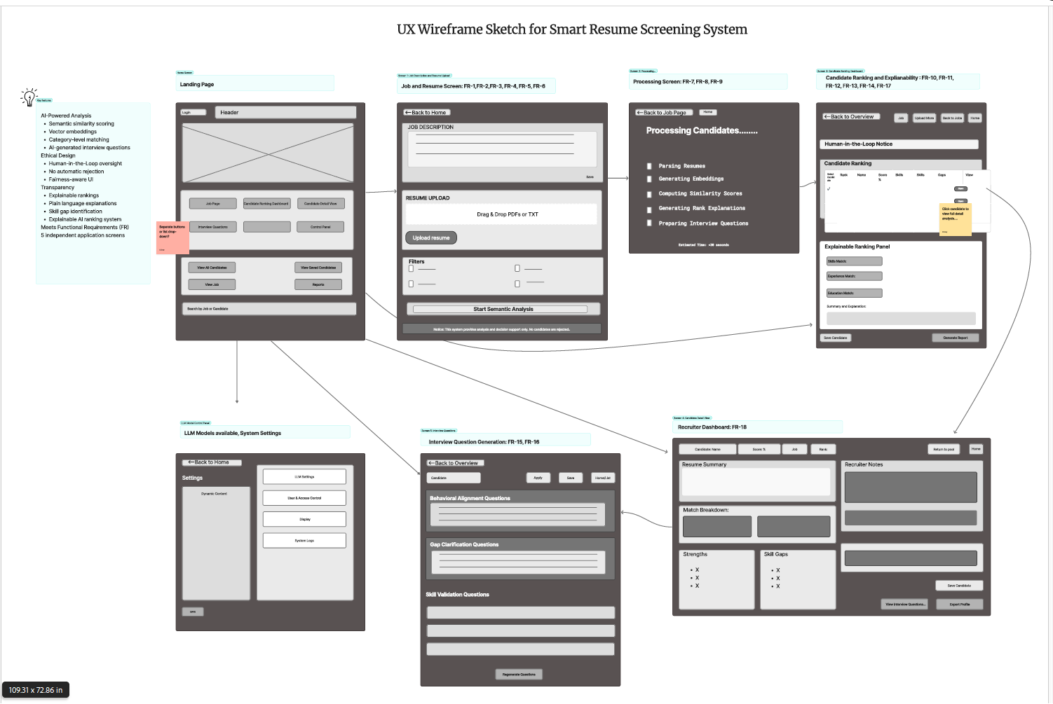
Ctrl + Click to view

Slide 11
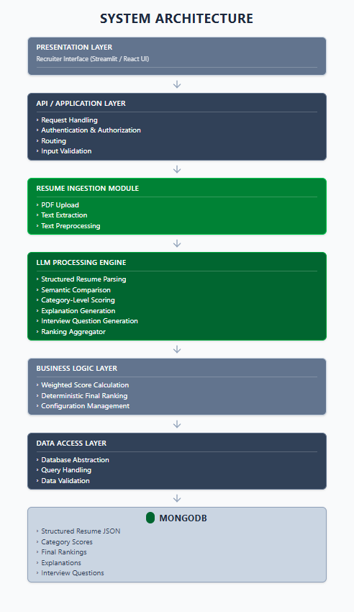
System Architecture Design

Slide 12
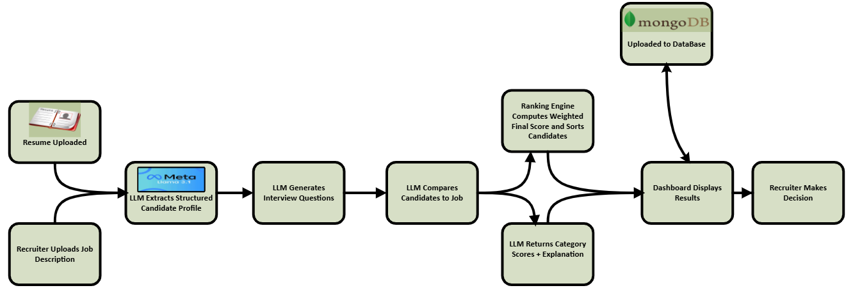
System Data Model Design

Slide 13
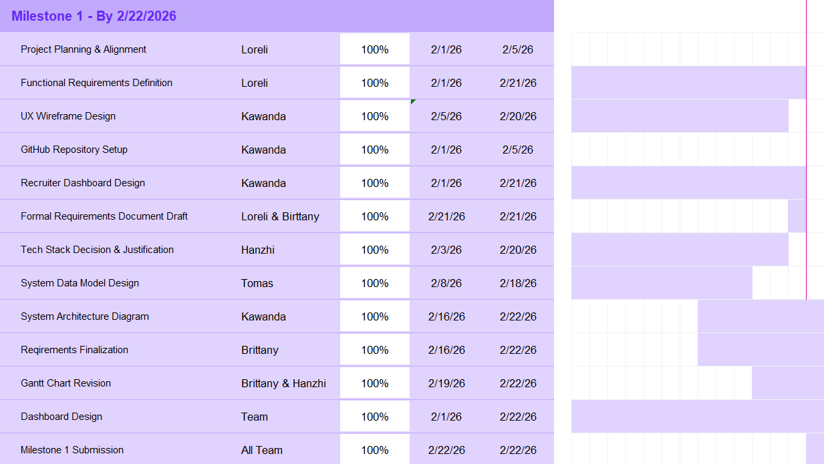
Gantt Chart (Milestone 1)

Slide 14
Gantt Chart Overall

Slide 15
Tech Stack Decision and Justification
.
Large Language Model: Llama 3.1 8B Instruct
Selected after benchmarking five open-source LLMs.
Demonstrated highest JSON reliability, schema consistency, and extraction accuracy.
Maintained structural integrity under formatting variation and OCR-style noise.
Prioritizes downstream stability over marginal speed improvements.
Semantic Matching: Sentence Transformers
Uses embedding-based comparison instead of keyword matching.
Enables similarity scoring across skills, experience, education, and projects.
Improves ranking accuracy and contextual alignment.
Database: MongoDB
Document-based schema supports semi-structured resume data.
Flexible structure aligns with extracted JSON candidate profiles.
Scales naturally with ranking outputs and interview data.
Frontend & Backend
React frontend for modular UI and dashboard components.
Python API backend for resume parsing, embedding generation, and ranking logic.
Deployment Strategy
API-based inference via Hugging Face (preferred for prototype).
Local deployment available as fallback option.
Fallback to smaller model (Llama 3.2 3B) if API constraints arise.

Slide 16
Action Plan for Milestone 2
Implement the resume ingestion and parsing pipeline to support PDF and Word (.docx) uploads with structured text extraction.
Develop semantic matching functionality, including embedding generation and similarity computation between resumes and job descriptions.
Design and implement the candidate ranking algorithm with weighted scoring across skills, experience, education, and project categories.
Integrate the interview question generation module based on identified strengths and gaps.
Complete end-to-end system integration connecting the frontend, backend API, LLM components, and database.
Conduct internal testing to validate ranking accuracy, response time, and workflow stability.
Finalize documentation and prepare the mid-semester demonstration.

Slide 17
Questions and Comments

